Slide 1
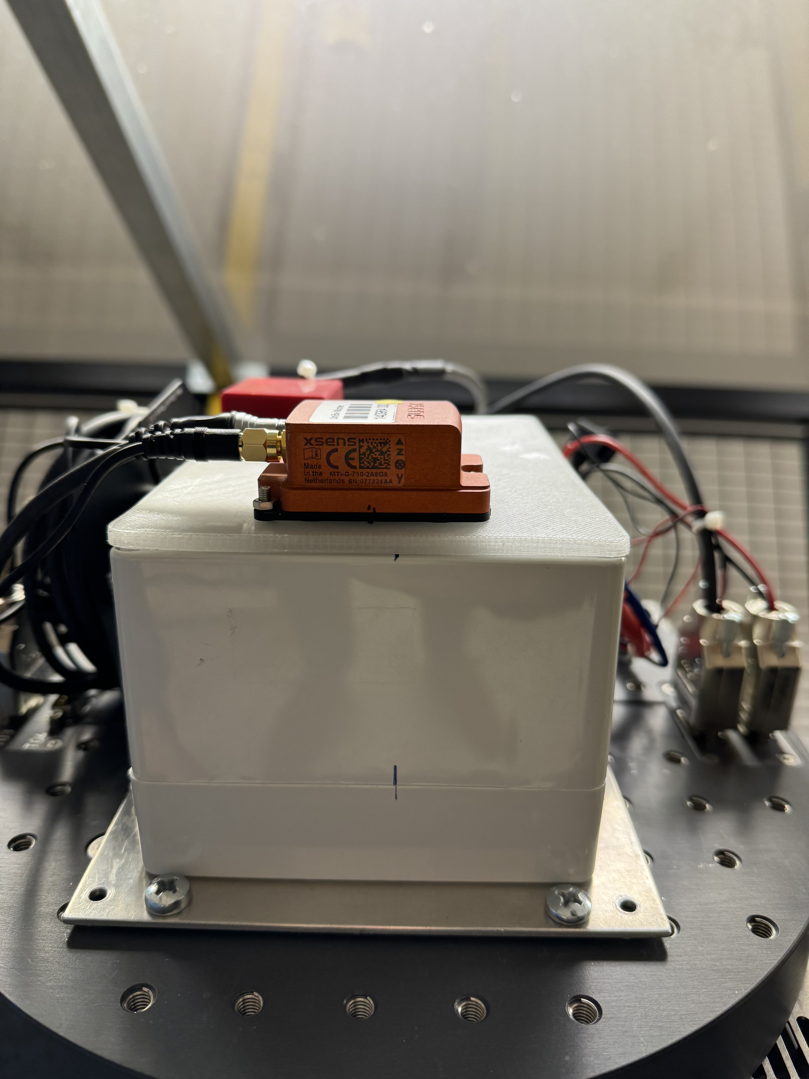


Ian Mambea Solomon
Low-cost Inertial Measurement Unit Calibration (IMU) with Shallow Neural Networks
Master Colloquium: 16.July.2024

Slide 2
Contents
Introduction
IMU error model
IMU calibration techniques
Methodology
Results
Conclusion (and Future works)
Master Colloquium: 16.July.2024

Slide 3
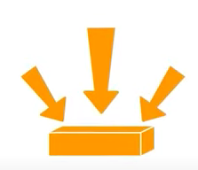
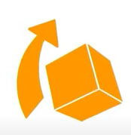
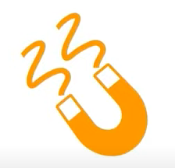
1. Introduction(1)
What is an Inertial Measurement Unit (IMU)?
An electronic device that measures:
Z
6-axis IMU
Acceleromer
+
Gyroscope
Force
y
X
Angular rate
Xsens MTi-G-710-2A8G4
)
(
)
(
9-axis IMU
Magnetometer
Magnetic field
Master Colloquium: 16.July.2024
Notes:
Accelerometers: linear acceleration (body specific force)
Displacement calculation
No account of turns to know the actual position
Gyroscopes: angular velocity
Orientation calculation
Magnetometers: strength and direction of magnetic field

Slide 4
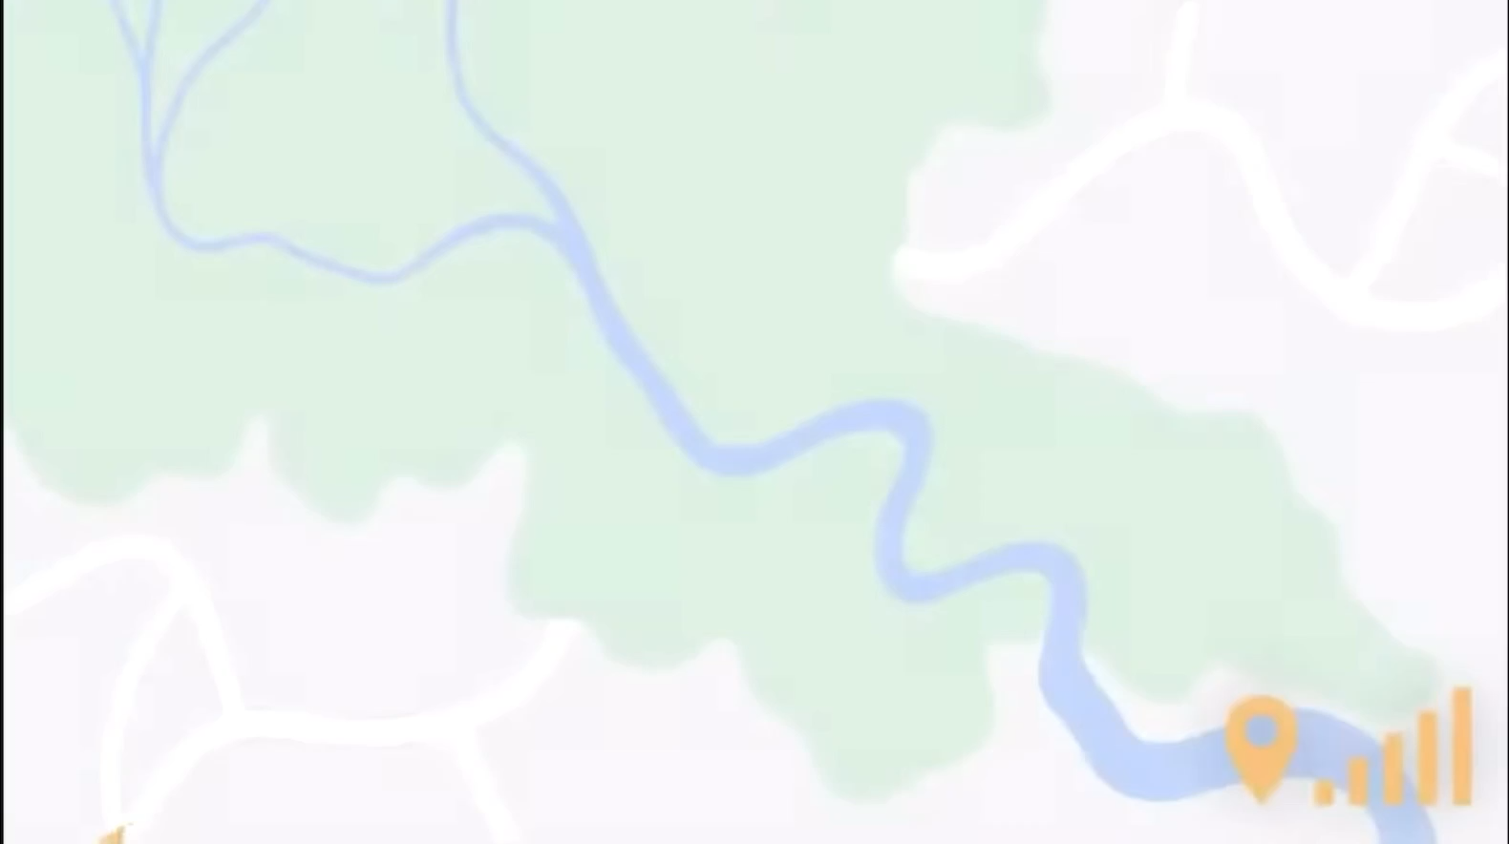
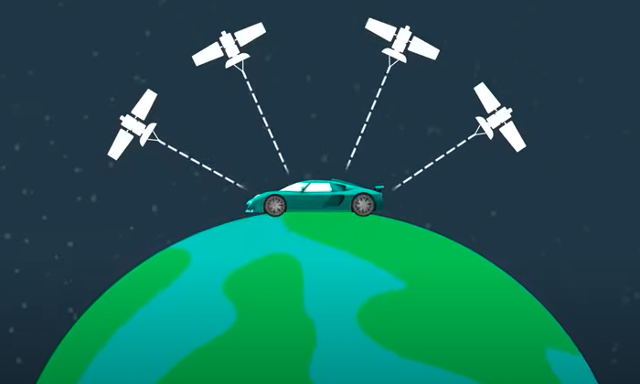
1. Introduction(2)
Why do we need IMUs?
For determining positioning using GNSS, at least four satellites must be reacheable and signal decorded.
One can’t know the body’s movement when there is a GNSS signal outage
Occlusions make the positioning from GNSS unreliable (unreachable) e.g.:
Underground tunnels
Dense building structures
Master Colloquium: 16.July.2024
Notes:
At least 4 satellites: signals received and decoded
Without GNSS signal, linear journey is estimated

Slide 5
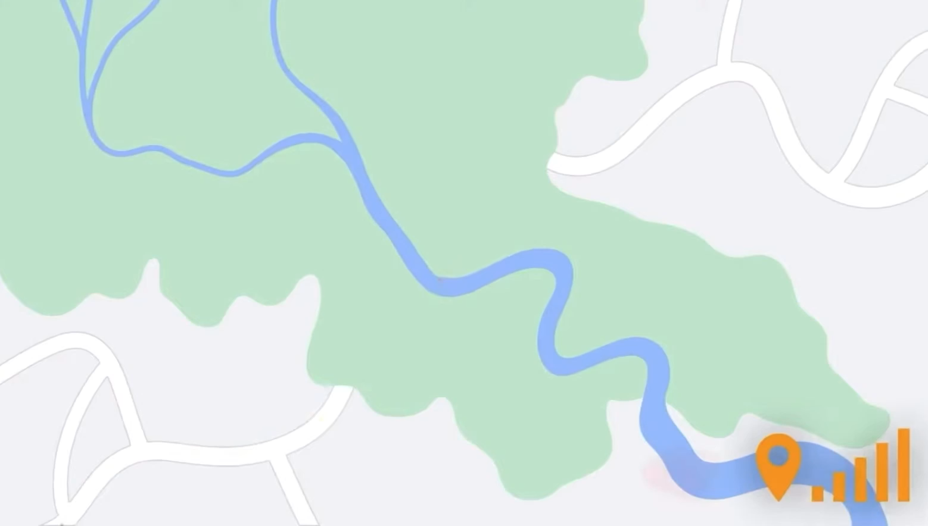
1. Introduction(3)
Why do we need IMUs?
GNSS + IMU = improved positioning
IMU will:
Use GNSS data as a reference point.
Use detailed motion of body
Improved accuracy and reliability
Enhance robustness
Algorithms used during post-processing of combined GNSS and IMU data to get accurate positioning.
Applications:
From Aerospace to wearable devices in hospitals
Master Colloquium: 16.July.2024
Notes:
Combination: data is processed to reliable capture the vehicles’s journey
IMU: high frequency motion data
GNSS: high accuracy position data

Slide 6
1. Introduction(4)
Micro-Electro-Mechanical Systems (MEMS)
Advantages
Small size, low cost
Highly reliable – because of size and weight, perform better in vibration and impact conditions
Require low power consumption
Disadvantages
Affected by temperature changes
Output results need to be controlled and compensated
Earth’s rotation can mask the gyroscope’s measurements
Xsens MTi-G-710-2A8G4
Master Colloquium: 16.July.2024

Slide 7
2. IMU error model(1)
Types of errors sources found:
Deterministic errors (constant errors)
Bias
Scale Factors
Misalignment
Cross-coupling
Stochastic errors (random based errors)
Random Walk (White Noise)
Bias Instability (Flicker Noise)
Idea is to compensate (calibrate) the sensors by reducing the deterministic errors using artificial neural networks (ANNs).
ANN can model complex non-linear relationships
learn intricate patterns and features from large datasets
Stochastic errors are difficult to compensate because:
Randomness and Unpredictability
Dynamic Environments
Master Colloquium: 16.July.2024
Notes:
Bias: offset present in sensor output even when there is no input
SF: proportional deviation from true value
Misalignment: non- orthogonality of sensor axis
Cross-coupling: motion of one axis affects the readings in another
RW: random fluctuations in sensor’s output
BI: slow, random variations in the sensor bias over time. (1/f noise - power density decreases with increase freq. or offset from signal)

Slide 8
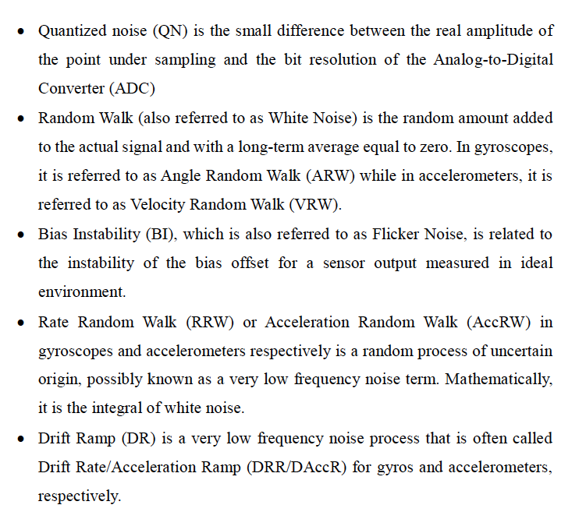
Master Colloquium: 16.July.2024

Slide 9
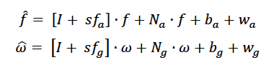
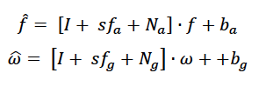
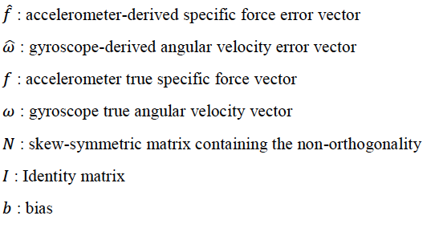
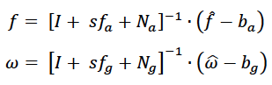
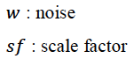
2. IMU error model(2)
Ignoring
random errors
‘Error free’ sensor measurements
Focus is on Gyroscope compensation
Master Colloquium: 16.July.2024

Slide 10
3. IMU Calibration Techniques(1)
IMU Compensation
Methods
Classical Methods
ANN
Master Colloquium: 16.July.2024

Slide 11
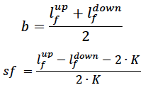
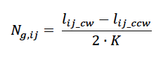
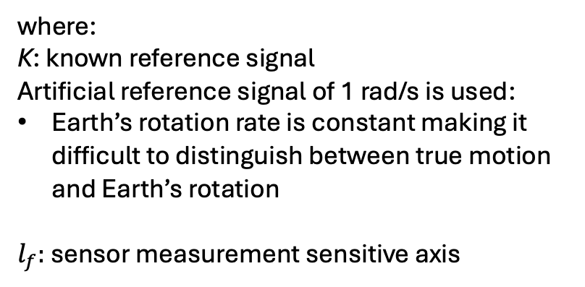
3. IMU Calibration Techniques(2)
IMU Compensation
Methods
Classical Methods
ANN
Six Position Static Test
where:
K: known reference signal
Artificial reference signal of 1 rad/s is used:
Earth’s rotation rate is constant making it difficult to distinguish between true motion and Earth’s rotation
$l_{f}:$ sensor measurement sensitive axis
Angle Rate Test
Master Colloquium: 16.July.2024

Slide 12
3. IMU Calibration Techniques(3)
IMU Compensation
Methods
Classical Methods
ANN
Series of simulation tests conducted
Employing different ANN techniques
Long short term memory network
Feed forward network
Strapdown technique
Using Strapdown technique on compensating on real data
Master Colloquium: 16.July.2024
Notes:
simulation tests: algorithm development and testing, validation and verification, parameter tuning, performance evaluation, and education
LSTM:
used in sequential data
allows network to remember important details from earlier in the sequence.
FFN:
straighforward mechanism
input - output relationship without temporal dependancies

Slide 13
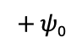
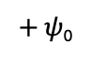
4. Methodolody(1)
$$∫$$
gyrorates
Gyro angles & heading
Sum of Squared Errors
heading and gyrorates
Pre-processing
Compare with heading and uncalibrated gyro angles
Gyrorates
Gyro
angles
$$∫$$
$+$ 𝜓₀
Update loss
$+$ 𝜓₀
Backward loss
( dy )
NN with Strapdown Technique
Strapdown Technique
Master Colloquium: 16.July.2024

Slide 14
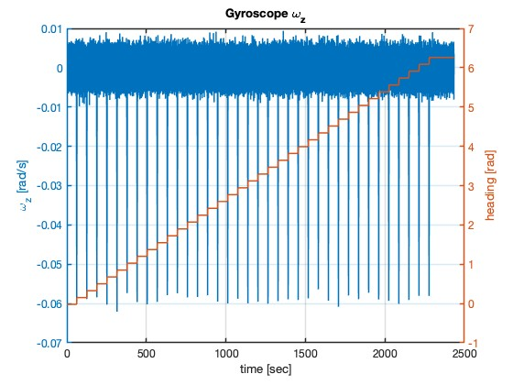
4. Methodolody(2)
heading and gyrorates
Gyro-rates: training data
Collected at a fequency of 200 Hz
Heading (gyro-angle): target data
Master Colloquium: 16.July.2024
Notes:
Higher sampling rates provide more data points, leading to a finer resolution in the captured data.

Slide 15
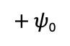
4. Methodolody(3)
$$∫$$
gyrorates
Gyro angles & heading
Sum of Squared Errors
heading and gyrorates
Pre-processing
Compare with heading and uncalibrated gyro angles
Gyrorates
Gyro
angles
$$∫$$
$+$ 𝜓₀
Update loss
$+$ 𝜓₀
Backward loss
( dy )
NN with Strapdown Technique
Normalization
better condition the data to equally contribute to the training process
NN can more effectively learn and generalize
Master Colloquium: 16.July.2024

Slide 16
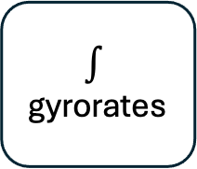
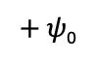
4. Methodolody(4)
$$∫$$
gyrorates
Gyro angles & heading
Sum of Squared Errors
heading and gyrorates
Pre-processing
Compare with heading and uncalibrated gyro angles
Gyrorates
Gyro
angles
$$∫$$
$+$ 𝜓₀
Update loss
$+$ 𝜓₀
Backward loss
( dy )
NN with Strapdown Technique
Inside the network, where losses are computed (and minimized)
Master Colloquium: 16.July.2024
Notes:
Here, weights and biases of the neural network are updated
Weights: strength of connections between neurons
Biases: allow neural networks to fit more complex patterns in the data

Slide 17
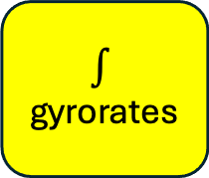
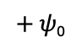
4. Methodolody(5)
$$∫$$
gyrorates
Gyro angles & heading
Sum of Squared Errors
$+$ 𝜓₀
Update loss
Backward loss
( dy )
NN with Strapdown Technique
NN cannot integrate
Only try to match the training data to the targets
Master Colloquium: 16.July.2024

Slide 18
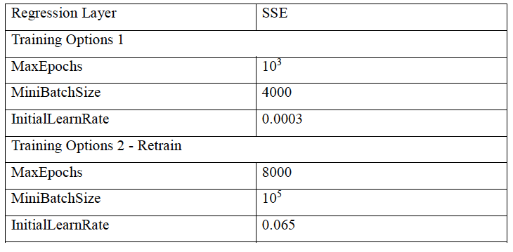
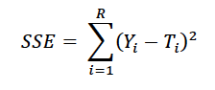
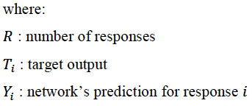
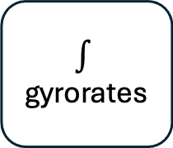
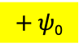
4. Methodolody(6)
$$∫$$
gyrorates
Gyro angles & heading
Sum of Squared Errors
$+$ 𝜓₀
Update loss
Backward loss
( dy )
NN with Strapdown Technique
Coarse alignment: aligning the IMU's coordinate frame with respect to an external reference frame.
Loss function: how well a given machine learning model fits the specific data set.
Master Colloquium: 16.July.2024
Notes:
Coarse alignment: determining an initial estimate of the system's orientation by aligning with the heading
Regression Layer: Model fitting (Goal is to minimize the loss: improving the accuracy of the model's predictions)
MaxEpochs: total no. of complete passes through the training dataset
MiniBatchSize: No. of samples per gradient update
Initial Learning rate: Sets the initial stepsize for parameter updates
Retraining: Allows further training of a pre-trained model

Slide 19
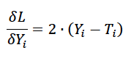
4. Methodolody(7)
$$∫$$
gyrorates
Gyro angles & heading
Sum of Squared Errors
$+$ 𝜓₀
Update loss
Backward loss
( dy )
NN with Strapdown Technique
Backward loss:
the process of calculating how much each parameter in the neural network contributed to the total loss
to minimize the difference between its predictions and the actual targets
Master Colloquium: 16.July.2024
Notes:
Backpropagation is the mechanism that allows neural networks to learn from data by adjusting their weights and biases to minimize the prediction error.
Done by computing the gradients of the loss with respect to the parameters of the network; the network learns to make more accurate predictions over time.

Slide 20
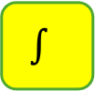
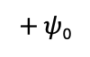
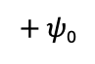
4. Methodolody(8)
$$∫$$
gyrorates
Gyro angles & heading
Sum of Squared Errors
heading and gyrorates
Pre-processing
Compare with heading and uncalibrated gyro angles
Gyrorates
Gyro
angles
$$∫$$
$+$ 𝜓₀
Update loss
$+$ 𝜓₀
Backward loss
( dy )
NN with Strapdown Technique
Integrate again because output of the network is gyrorates
Master Colloquium: 16.July.2024

Slide 21
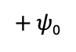
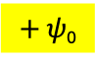
4. Methodolody(9)
$$∫$$
gyrorates
Gyro angles & heading
Sum of Squared Errors
heading and gyrorates
Pre-processing
Compare with heading and uncalibrated gyro angles
Gyrorates
Gyro
angles
$$∫$$
$+$ 𝜓₀
Update loss
$+$ 𝜓₀
Backward loss
( dy )
NN with Strapdown Technique
Coarse alignment: aligned predicted = predicted + psi₀
[Heading(1,1) – Predicted gyro angles (1,1)]
Master Colloquium: 16.July.2024

Slide 22
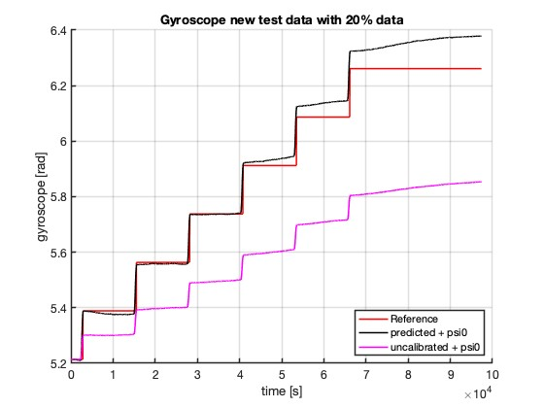
5. Results(1)
The network understood the characteristics of the data
Uncalibrated (plus coarse alignment): original noisy gyrorate signal that is integrated to get gyroangle
Predicted (plus coarse alignment): output from the NN after losses are minimized
Master Colloquium: 16.July.2024

Slide 23
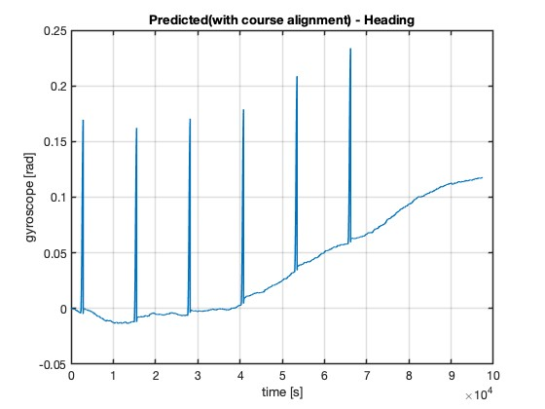
5. Results(2)
Ignore the vertical lines which represent the transition points between the static rotation angles.
Predicted – Reference ≈ very small
Deviations represent presence of drift which is caused by random errors (white noise).
Master Colloquium: 16.July.2024

Slide 24
6. Conclusion and Future works (1)
Advantages:
Adaptive learning with multivariate dependacies
Reduce calibration time
Disadvantages
Computational complexity (efficient algorithms and hardware)
Generalization techniques
Master Colloquium: 16.July.2024
Notes:
Adaptive Learning: NN adapt to new data and conditions (non-linear models), potentially improving their accuracy over time with retraining
Multivariate dependencies: NN can simultaneously consider multiple factors and their interactions. e.g. sensor biases
As compared to Classical, the time spent to calibrate is less
Generalization techniques: trial and error methods. e.g. activation functions (to introduce non-linearity in the model)

Slide 25
6. Conclusion and Future works (2)
Future works
Attitude estimation: update the orientation of the vehicle or device
Complimentary filtering with calibrated accelerometer data to improve the accuracy of the attitude estimation
Sensor fusion with GNSS to correct for long-term drift in the IMU-based estimates
Master Colloquium: 16.July.2024
Notes:
Filters like complementary filters or Kalman filters are commonly used to fuse these sensor inputs, leveraging the strengths of both sensor types.

Slide 26
References
Solomon, I.M (2024). Low-cost Inertial Measurement Unit (imu) calibration with Shallow Neural Network, Technical University of Munich
What is IMU | A simple guide to Inertial Measurement Unit │IMU application for CAN networks https://www.youtube.com/watch?v=fG-JQlzQxWQ&ab_channel=InfluxBigData
Master Colloquium: 16.July.2024

